Slide 1
.NET Conf Announcements for Mobile Developers
Alejandro Ruiz
Microsoft Developer Technologies MVP
alejandro@alejandroruizvarela.com

Slide 2

.NET any developer, any app, any platform

Slide 3
Topics
Android
iOS
Xamarin.Forms

Slide 4
Android

Slide 5
Android Pie Support
Display Cutout Support
Notifications Enhancements
Indoor Positioning

Slide 6
Android Emulator Hyper V on Windows

Slide 7
Improvements on Build Time
Smart Hotel 360 Demo App.
25 lines of code
99 NuGet packages
32 XAML Screens
from 2:15s(Current Release) to 0:57s(Master Branch)
Xamarin.Android.Lite (PoC)
Rebuild and Run in 3 seconds

Slide 8
And More…
AXML Tools for Preview Data
Split Editor
Automatic SDK Management

Slide 9
iOS

Slide 10
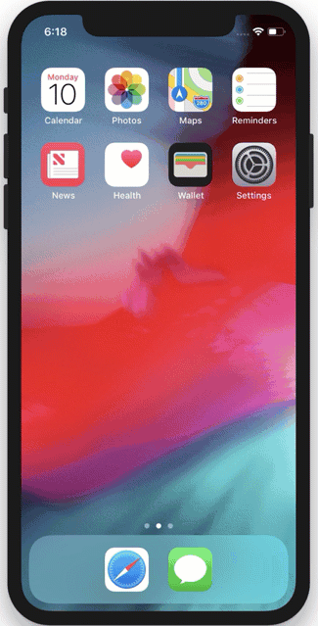
iOS 12 / Xcode 10 Support
Shortcuts - Intents, Siri Integration

Slide 11
ARKit 2.0
3D Object detection and tracking
Environment Texturing – real world object reflection
Persist AR environments between sessions
Multi-person experiences

Slide 12
And More…
Natural Language Framework
New Network Stack (NW* APIs)
CoreML Custom Layers & Custom Models
CarPlay
Grouped Notifications
Interactive Controls in Notifications

Slide 13
Xamarin.Forms

Slide 14

New Version Release 3.2.0
Android Fast Scrolling, Fast Renderers
Layout Compression
Native Forms
Android Bottom Tabs
TittleView
Bindable Span
Button Padding
OnPlatform & OnIdiom XAML Extensions
Intellisense improvements

Slide 15
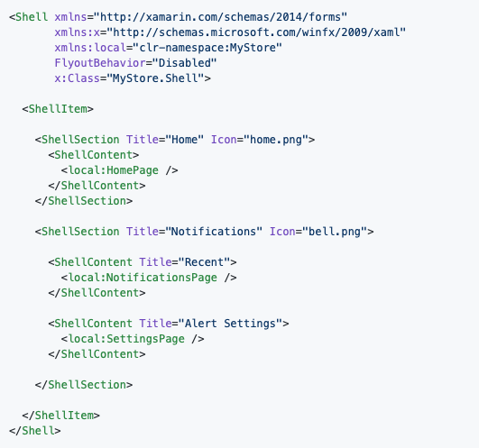
Forms Shell
An optional Skeleton for you application
Consistent look and feel(global settings and CSS styles)
API Handles navigation
Deep Linking
Material Look and feel

Slide 16
CollectionView & CarouselView
Support Horizontal/Vertical Layouts
Modern ListView Impl.
No longer cell now use regular Views / Data Templates

Slide 17
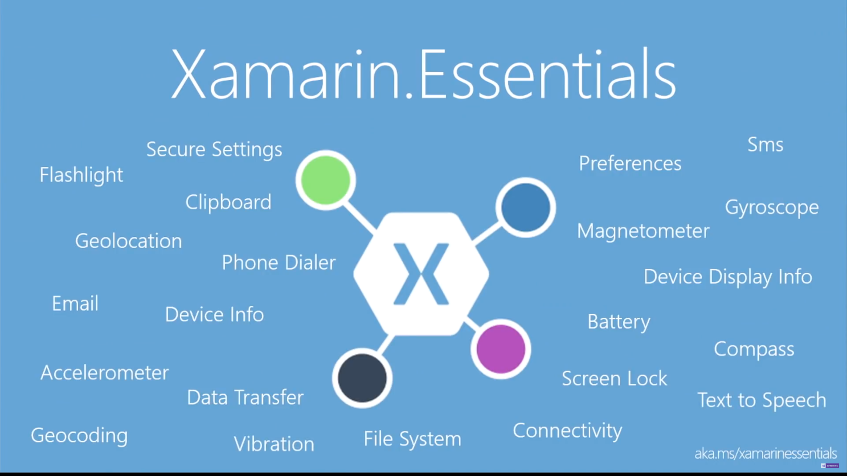

Slide 18
Questions?
Alejandro Ruiz
Microsoft Developer Technologies MVP
.NET Conf Announcements for Mobile Developers
Demo Code: https://github.com/AlejandroRuiz/DotNetConf2018
alejandro@alejandroruizvarela.com
http://alejandroruizvarela.blogspot.com
https://github.com/alejandroruiz
@alejandroruizva

